Slide 1
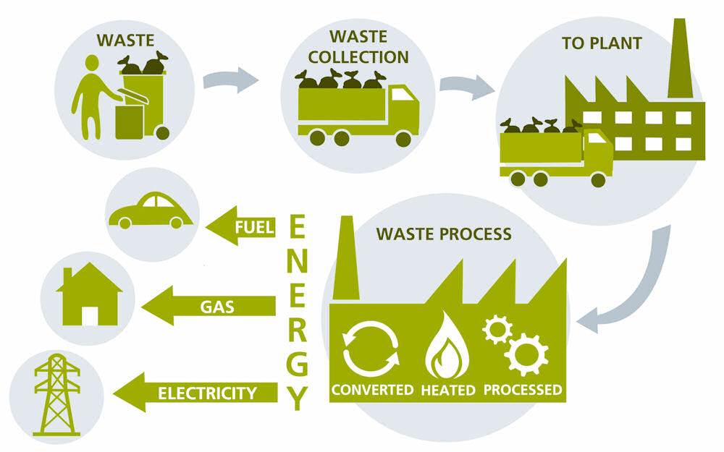
SWILL WASTE MANAGEMENT COMPANY
VISION- To be a center of excellence in the sustainability of the country's ecosystem via our commitment to offering extensive and long-term resource-efficient solutions to the sustainability challenges faced by society.
Mission statement: To develop a secure, economical, and efficient collection, disposal, and recycling system that safeguards the global ecosystem while driving the country's efforts to achieve global cleanliness standards.
Objective: To strengthen and broaden the Swachh-Bharat Mission via the use of scientific methods, techniques, and excellence. To develop financially feasible and sustainable waste management strategies. Identify, create, and implement technologies for treating waste in order to generate electricity, waste recycling, and obtain valuable assets.
WEALTH

Slide 2
ABOUT BHOPAL
Population- 26Lakhs approx.
area - 2,772 sq km.
350 sq.km is urban and 2422 sq.km is rural.
urban area -19 Lakh
rural area – 4Lakh
households are in urban - 408,747.
households are in rural area- 93,058.
Population density (6290 people per sqm).
City divided into 85 wards.
Waste generation per person = 0.46Kg (avg.)/ day (online statistics).
Total waste generation forecasted this year = 1095 tones / day.
Ideal Target for acquiring waste: 900 tons per day.

Slide 3
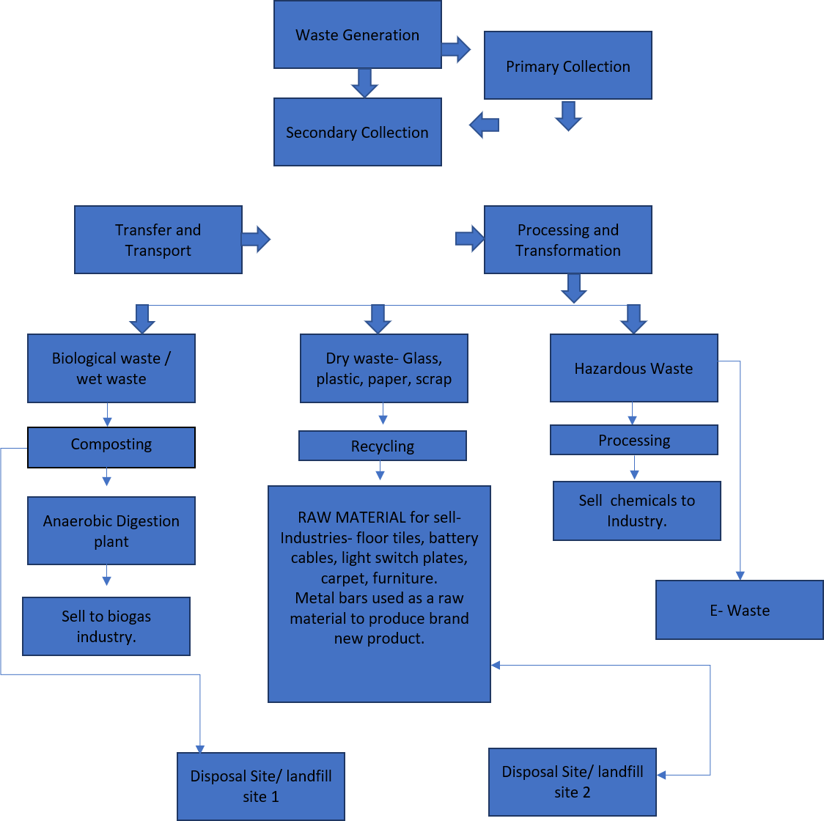
OPERATIONAL FUNCTIONS OF WASTE MANAGEMENT

Slide 4
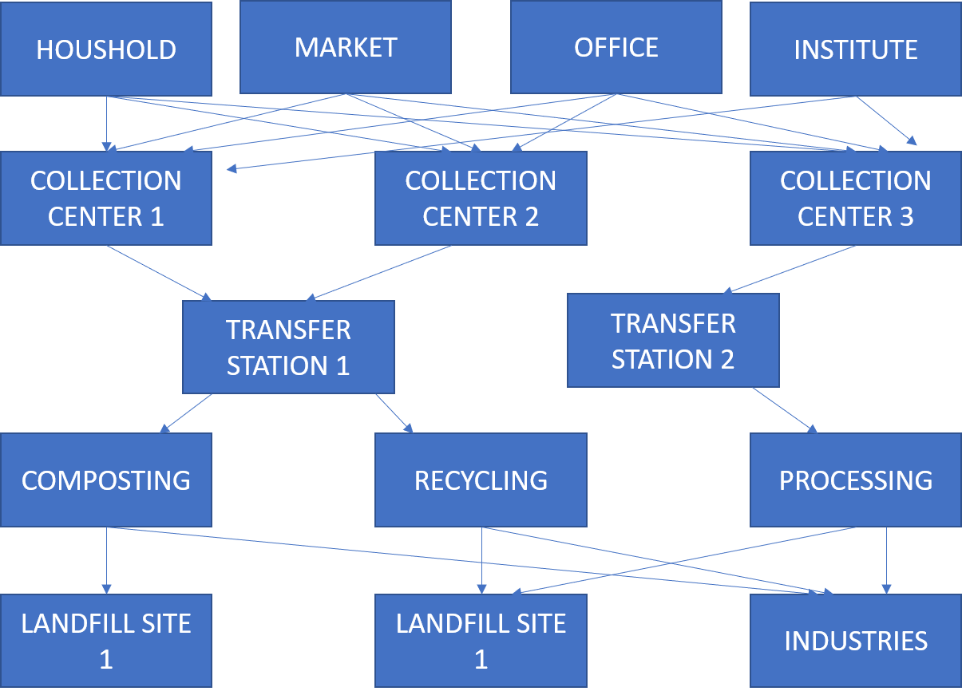
OPERATIONAL FUNCTIONS PATH

Slide 5
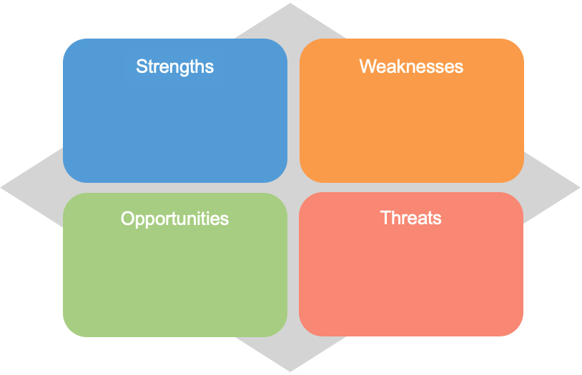
MARKETING DEPARTMENT
“Extracting BEST from your WASTE”
PUBLIC AWARENESS
Outreach to schools and societies to educate people
Distributing Segregated Dustbins
Residential visits to demonstrate the process.
Acknowledging the top residents from each ward.
Random House-hold Inspections and imposing penalties
1. Industrial waste management
2. Large customer base
3. B2B Marketing
Expansion
Additional cost
High training cost and development cost
Government Initiatives
Booming Industry
Power generation via trash
Competitive market
Limited skilled human resource
Government Regulation
PRODUCT STRATEGY- 7 services for individual households and 9 for companies.
Pricing Strategy: Pricing approach is dynamic
Promotion Strategy: "Be Sustainable" initiative
Place Strategy: Remarkable creation for both homeowners and small businesses
MARKETING STRATEGIES

Slide 6
HUMAN RESOURCE DEVELOPMENT
HR management and Sustainable development & waste management The last 2 questions that need to be answered are related directly with HR.
The new ways of doing the business, as well as new regulations for sustainable development & waste management, requires additional extra paperwork.
This means that a certain fob positions, will be affected with increasing workload, as well as demand of new knowledge, skills and abilities related with new technology development as well as administration of regulations covering this issues.

Slide 7
HUMAN RESOURCE FUNCTION
Additional administration and documentation
Additional workload [specific]
Demand new knowledge
Additional skills and abilities
Job work changes

Slide 8
HUMAN RESOURCE DEVELOPMENT
That is also in connection with the Disposal Technology Development and Deployment Job design - these seek to phase out any type of disposal that does not effectively recover the material and energy value of waste materials; promote technologies that efficiently capture the material and energy value of materials; identify carbon neutral or carbon negative waste disposal methods for the residual waste after maximum waste prevention, reuse, recycling and composting.
In a very simple sense, HR Management and sustainable development & waste management are connected with the job positions that are affected from the waste management treatment, and the result is need of new job design, or redesign

Slide 9
THANK YOU

